Slide 1
Database indexes
Software Performance Engineering

Slide 2
Database Indexes
A database index is a data structure that enables fast lookups
Trade: gain speed vs. cost of size
Trade: gain read vs. cost of updates
Alternative is a full table scan
Also: aids in sorting data
Also: enforce uniqueness constraints
Common algorithms: hash tables, b-trees, and more
Usages
Unique vs. Non-unique
Partial indexes
Single column vs. Multi-column

Slide 3
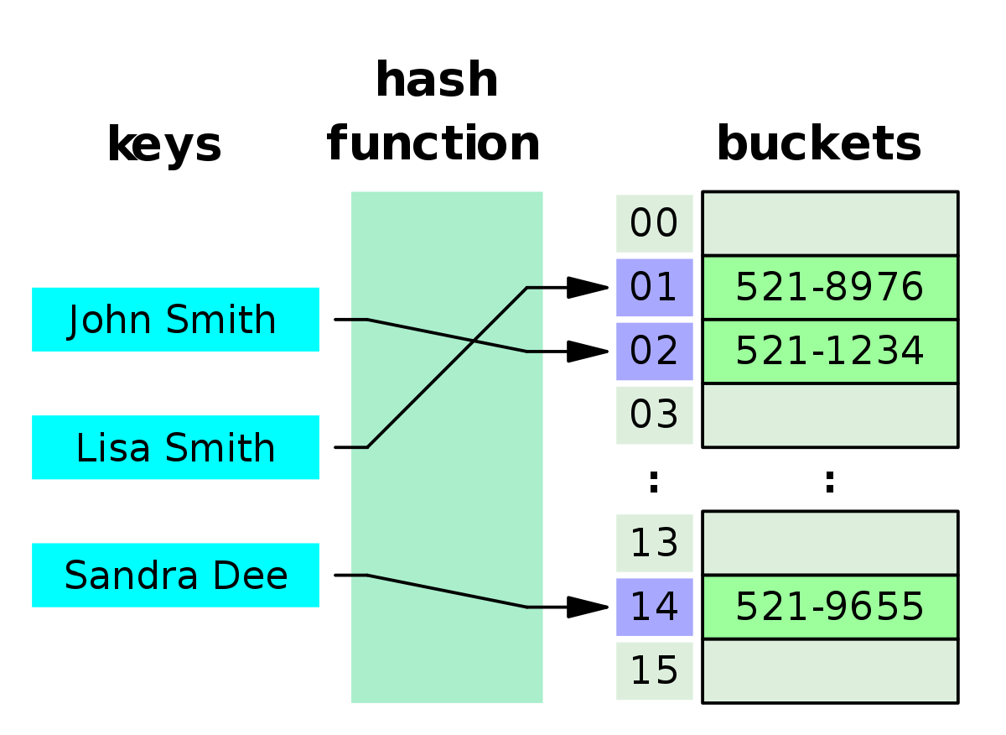
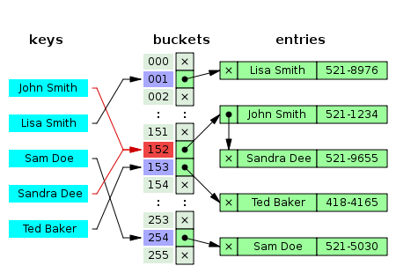
Hash Tables
Essentially, an array of linked lists with a hashing function
Given a key, provide the disk location of the row
key → hash(key) → index of the array → traverse linked list
Hash tables provide provably constant time lookup
Hash tables are memory-friendly
Linked lists can be malloc’d at random
Scaling & rebuilding is not very expensive
But! Hashes are generally good for single, unique lookups
Can’t speed up ORDER BY
Can’t search for inequalities
Most DBMS’s recommend B-tree instead anyway
Images from Wikipedia

Slide 4
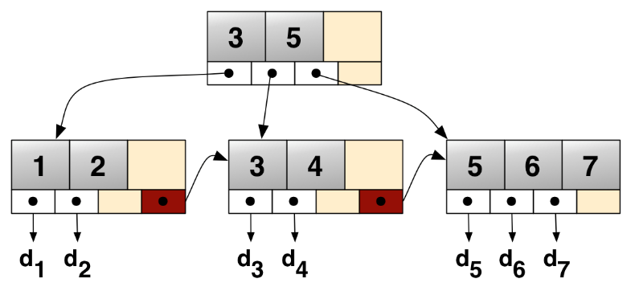
B-trees
NOT the same thing as binary tree, rather an n-ary tree, a generalization of a binary tree
Most common subtype for databases: B+Tree
A commonly-used, all-purpose indexing algorithm
High branching factor b, so high fanout
Structure of a B+tree
Single root node
Multiple layers of intermediate nodes
One layer of leaf nodes
Leaves maintain a sorted linked list for quick traversal
Maintain rules about how many children per node and how many items per node
In practice:
Nodes are usually a byte-sized array
A 3-level B-tree handles 255³=16.6 million records
You can usually cache the root and first layer anyway, so most reads only involve 1-2 disk reads
B+Tree image from Wikipedia

Slide 5
B+Tree Operations
Search
Start at root, traverse to the tree based on inequality
Constant-time searches on a given node (usually 255)
Only looking up a few nodes
Once you find the first, follow the linked list to get the rest of the range
Insert
Do a tree search to determining bucket
If the bucket is full, split the bucket into a new one
Continue splitting up and down until you have enough room
Re-balancing only impacts max of 2 leaves and some parents
Bulk-loading
Sort the data first
Load in data from the leaves, creating and updating root as you go
Cheaper than many inserts at once

Slide 6
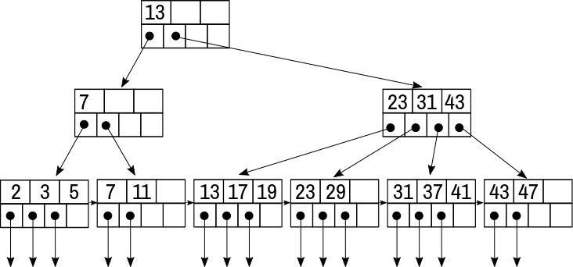
Example B+tree

Slide 7
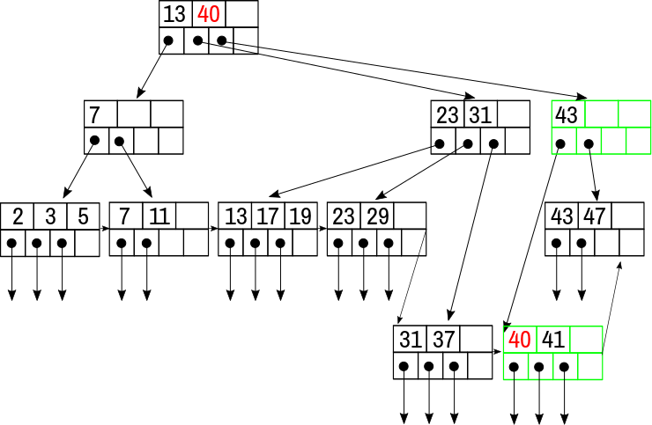
Example B+tree
Inserted 40

Slide 8
Unique vs. Non-Unique Indexes
Most database index algorithms support non-unique indexes
Hashes, B+trees, etc.
But the implementation is slightly different
Database indexes will always perform better if they KNOW that the index is intended to be unique
Add this as a constraint to your table
Column constraint on the CREATE TABLE or ALTER TABLE
Or CREATE UNIQUE INDEX instead of CREATE INDEX

Slide 9
Multidimensional Indexes
Some data is inherently multidimensional (“data cubes”)
e.g. latitude & longitude, or customer purchase data
Two problems
Nearest-neighbor queries: “Find closest bathroom to this lat-long”
Partial match queries, “Find all bathrooms near this lat”
Partitioned hash tables: modify the hash function to take in multiple arguments
Can’t handle range queries
Grid files: generalization of hash tables
Multi-dimensional array
Combine array indexes into “ranges” to be more sparse
B+tree: combine the conditions together
Mixed values on the leaves
Order of columns can matter in how you declare them
But there are specialized algorithms for this…

Slide 10
Multidimensional Indexes (2)
kd-Trees
K-dimensional search trees
Binary search tree, alternating layers between dimensions
Partial queries: square-root in number of leaves, not logarithmic
Not automatically balanced
Quad trees
Each node represents a k-dimensional cube
Each face of the cube represents a boundary range with 2^{k} children
Named after the 2-dimensional case: branching factor of 4
R-Trees
In the spirit of B-trees, with some rectangle intersection
“Two rectangles that don’t intersect won’t intersect any smaller rectangles contained within”
Group objects on the multi-dimensional space by minimum bounding rectangles
Create a tree structure around that

Slide 11
Multi-column Indexes
In practice, the way we create multi-dimensional indexes is to simply an index on multiple columns
CREATE INDEX locations_on_lat_lon ON locations(lat,long);
However, many will default to B+tree and won’t make use of how it will be queried
Carefully test and choose your indexes on this one
Again, go to the docs for recommendations on this
e.g. PostgreSQL
The GiST index is a mixture of various algorithms designed for multi-dimensional situations
SELECT * FROM places ORDER BY location <-> point '(101,456)'
The GIN index is built for layered data and document-oriented storage (e.g. JSON) where data is repeated a lot
BRIN (Blocked Range Indexes) are better for partially-sorted data
e.g. MySQL originally had these as extensions

Slide 12
Bitmap Scans
(Not to be confused with Bitmap Indexes – slightly different thing)
Most databases have the ability to combine index lookups
Conduct the lookups and put them into a bit vector
Run AND/OR/XOR on the vectors as needed
This is an alternative to creating multi-column indexes
Which is faster? Multi-column or bitmap scans of single-column? Depends.
This all come down to the query planner
This can help understand EXPLAINs though

Slide 13
Partial Indexes
You can also create indexes on some, but not all, data, e.g.
CREATE INDEX access_log_client_ip_ix ON access_log (client_ip) WHERE NOT (client_ip > inet '192.168.100.0' AND client_ip < inet '192.168.100.255');
Smaller indexes are more likely to cached and faster to traverse
Avoid indexing common values
Avoid indexing uninteresting values (e.g. “unbilled”)
Good way to build in your knowledge of the table’s distributions
Also this is great way to check for existence without hitting the table itself, especially if it’s unique
(called an “Index-only” scan….)

Slide 14
Index-Only Scans
In many database systems,
If the query includes only the columns in an index, then…
Only the index gets looked up
For example (from PostgreSQL docs)
Suppose we have a table t with x,y, and z.
x and y are indexed in a single index, z is not
SELECT x, y FROM t WHERE x = 'key'; # YES! INDEX-ONLY!
SELECT x FROM t WHERE x = 'key' AND y < 42; # YES! INDEX-ONLY!
SELECT x, z FROM t WHERE x = 'key'; # No. Not index-only
SELECT x FROM t WHERE x = 'key' AND z < 42; # No. Not index-only
Again, this comes out in EXPLAIN as to whether or not you are expecting it
Drawback: space!
Check the docs for your system

Slide 15
Expression Indexes
You can also make an index on a manipulation of the data
SELECT * FROM people WHERE (first_name || ' ' || last_name) = 'John Smith';
This is handy for situations where you:
Don’t want to create duplicate data (e.g. “full_name”)
Will be searching on the full data a lot
In practice, this feature is finicky
One small change to the schema means the index goes unused
Can be found using EXPLAIN

Slide 16
Tips for Indexes
Make sure the database query planner has the right information for planning
e.g. PostgreSQL’s ANALYZE counts data distributions
On small tables, sometimes using an index is slower. A query planner (usually) gets this right
Some indexing structures need upkeep from inserts
Rebuilding an index on an existing table vs. from an empty table
e.g. PostgreSQL’s CLUSTER table USING index
Some indexes have concurrency concerns
Some index data structures don’t take concurrency very well
Rebuilding the index sometimes causes big locks
Read the docs!
Common wisdom that we should test in future lab experiments:
Indexes also benefit from the NOT NULL constraint
Integers index faster than text
Using both a single-column index and a multi-column index can see a benefit
Name your indexes. This will make maintainability and EXPLAINS easier. Have a common convention, too. E.g “usernames_on_emails”

